Slide 1
Distributed Services Dependency Discovery from Log
Project Proposer: Wenbo Qian
Mentors: Alison Yao

Slide 2




Complex Service Interaction
Storage service
Resource
management
User Interface
Data movement
more…
Load shift
Monitoring
Scheduling
Config change
Code update
Notes:
So, as the number of interacting services grow, changes such as code updates, configuration changes or load shifts in one service can lead to subtle interaction and trigger unexpected behavior in other services. Such unexpected service calling relationship can cause catastrophic consequence.

Slide 3
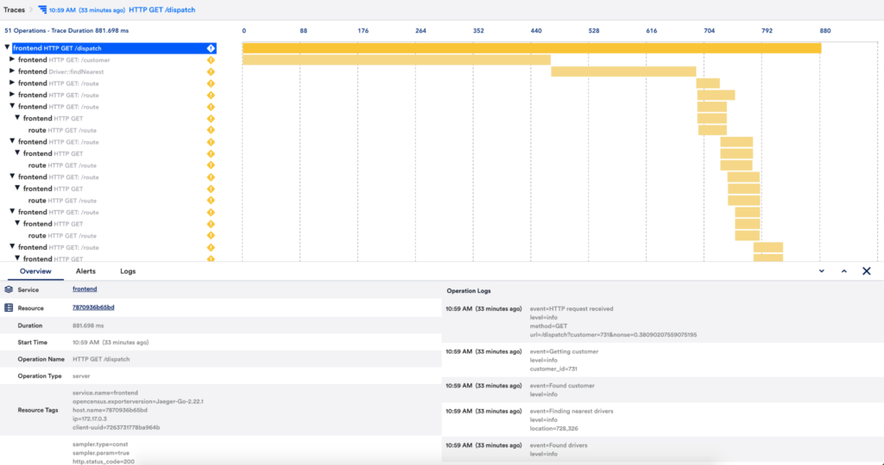
Service tracing is necessary for debugging
Notes:
Traditional approaches to dependency mapping rely on static configuration files, manual documentation, or instrumented distributed tracing. However, these methods have significant limitations: configuration files drift from reality, documentation requires constant maintenance, and tracing instrumentation may be incomplete or unavailable in modern cloud systems.

Slide 4
Building service dependence is not easy
Traditional approaches are impractical in modern cloud systems
Documentation becomes outdated quickly and requires continuous maintenance.
Tracing across heterogeneous tech stacks demands heavy engineering effort.
Service context isn’t shared effectively across teams, hindering coordination.
Notes:
Traditional approaches to dependency mapping rely on static configuration files, manual documentation, or instrumented distributed tracing. However, these methods have significant limitations: configuration files drift from reality, documentation requires constant maintenance, and tracing instrumentation may be incomplete or unavailable in modern cloud systems.

Slide 5

Identifying service dependency in production cloud system
Timestamp | BOOT_ID | SYSLOG_IDENTIFIER | MESSAGE
20...247953Z | ef0…ac | kernel | veritysetup invoked oom-killer: gfp_mask=0xcc0(GFP_KERNEL)…
20... 250752Z | ef0…ac | kernel | …
2023-09-15T16:19:20.705592 | ef0…ac | kernel | oomkill:constraint=CONSTRAINT_MEMCG,nodemask=(null),cpuset=support.slice,mems_allowed=0,oom_memcg=/support.slice/RepairAgent.RepairAgent_23_9_7003_0.service,task_memcg=/support.slice/RepairAgent.RepairAgent_23_9_7003_0.service,task=RepairAgent,pid=3820648,uid=0
Kernel log
veritysetup
RepairAgent
Notes:
in this case only analyzing kernel/system log has no direct evidence showing service relationship, so developers need to analyze more log context to reconstruct the service dependency.

Slide 6

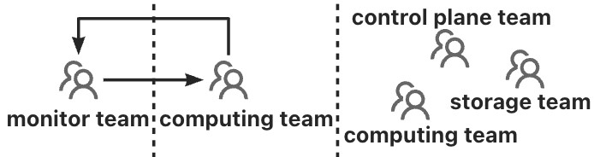

Identifying service dependency in production cloud system
Timestamp | BOOT_ID | SYSLOG_IDENTIFIER | MESSAGE
20...247953Z | ef0…ac | kernel | veritysetup invoked oom-killer: gfp_mask=0xcc0(GFP_KERNEL)…
20... 250752Z | ef0…ac | kernel | …
2023-09-15T16:19:20.705592 | ef0…ac | kernel | oomkill:constraint=CONSTRAINT_MEMCG,nodemask=(null),cpuset=support.slice,mems_allowed=0,oom_memcg=/support.slice/RepairAgent.RepairAgent_23_9_7003_0.service,task_memcg=/support.slice/RepairAgent.RepairAgent_23_9_7003_0.service,task=RepairAgent,pid=3820648,uid=0
Kernel log
message
queue
fork
Rpc
veritysetup
Service A
…
RepairAgent
Node 0,2
Node 1,3
Node 0,3
Team-by-team effort
Notes:
In cloudX confirming cross-service interaction becomes a team-by-team effort, where each team inspects their own services behavior independently, which is time-consuming
So we ask is it possible to automatically building cross-service interactions from logs?

Slide 7
Our approach: Automatically Building Services Dependency from logs
Timestamp | BOOT_ID | SYSLOG_IDENTIFIER | MESSAGE
20...247953Z | ef0…ac | kernel | veritysetup invoked oom-killer: gfp_mask=0xcc0(GFP_KERNEL)…
20... 250752Z | ef0…ac | kernel | …
2023-09-15T16:19:20.705592 | ef0…ac | kernel | oomkill:constraint=CONSTRAINT_MEMCG,nodemask=(null),cpuset=support.slice,mems_allowed=0,oom_memcg=/support.slice/RepairAgent.RepairAgent_23_9_7003_0.service,task_memcg=/support.slice/RepairAgent.RepairAgent_23_9_7003_0.service,task=RepairAgent,pid=3820648,uid=0
VeritySetup
Extract events and timestamps
Relationship analysis
2023-09-15T16:08:14. 247953
VeritySetup
happens-before
2023-09-15T16:19:20.705592
Repair Agent
…
Notes:
Basic idea is: Log include rich service interaction hints, nearly every service produces logs that contain implicit signals about inter-service communication: HTTP requests, RPC calls, database queries, and message queue interactions.

Slide 8

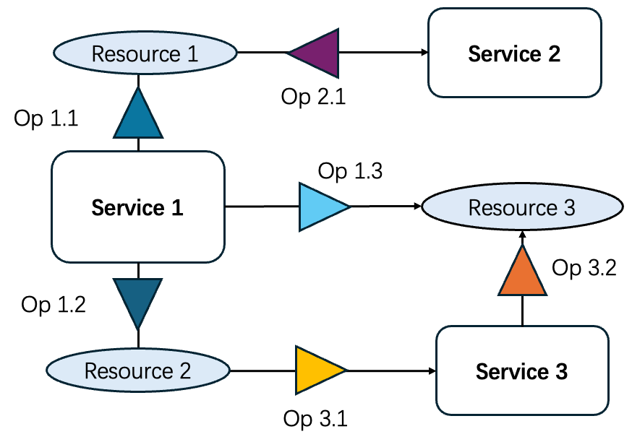
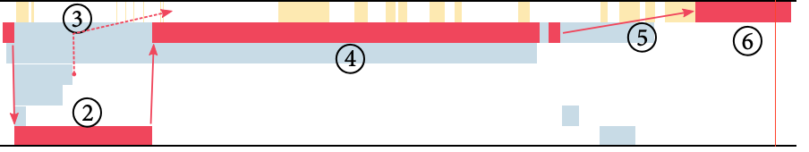
Overview
{Veritysetup, Veritysetup.*,
RepairAgent, RepairAgent.*,
Resource invocation}
LLM
system log
node log
…
Events Extractor
LLM
Higher-level modeling
Symptom Extraction
Building Service Dependency
Notes:
Basic idea is: Log include rich service interaction hints, nearly every service produces logs that contain implicit signals about inter-service communication: HTTP requests, RPC calls, database queries, and message queue interactions.

Slide 9
1. Agent-based events extraction
{Veritysetup, Veritysetup.*,
RepairAgent, RepairAgent.*,
Resource invocation}
LLM
system log
node log
…
Events Extractor
Enhance with regex
Notes:
The second step is to extract all services interaction involved in the cross-service performance issue.
The challenge is: how to accurately reconstruct this hidden interaction from noisy text without requiring domain-specific instrumentation for every new service.
So we employs an agent-based interaction extractor to infer interactions between applications using logs and traces outputted from the Lightweight Anomaly Detector.
The output of this step will be a tuple means interaction type: (see slides)

Slide 10

2. Casual relationship analysis
Happens-Before
A
B
Mutual Exclusion
A
B
B
A

Slide 11
3. Building Service Dependency
Service 2
Resource 1
Op 2.1
[
{"
"service_a",
"operation_a",
"service_b",
"operation_b",
"resource",
"},
…
]
Op 1.1
Service 1
Op 1.3
Resource 3
Op 3.2
Op 1.2
Service 3
Resource 2
Op 3.1

Slide 12
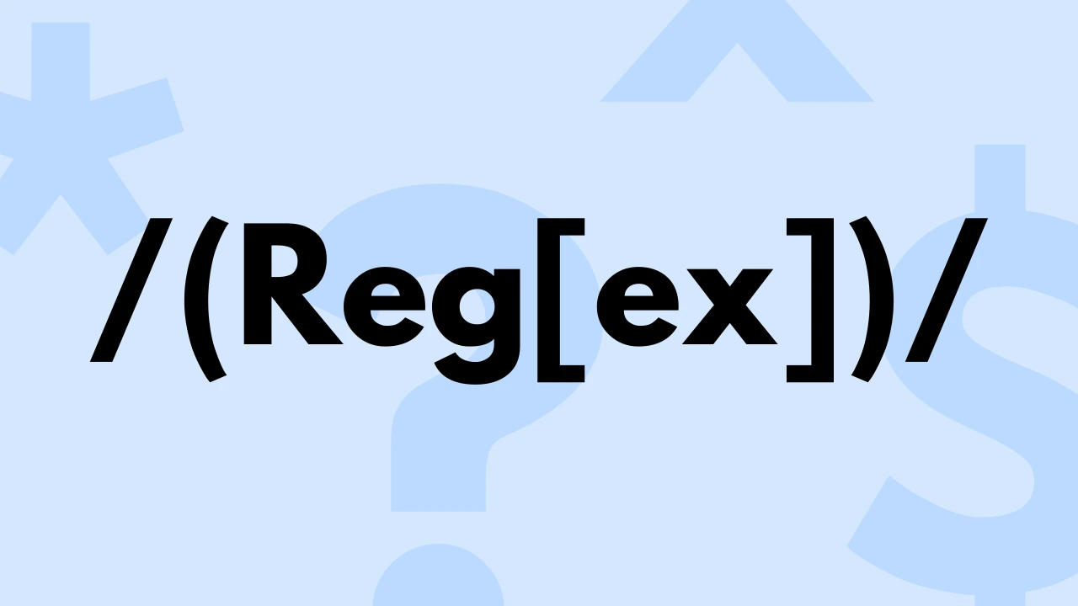


4. Dependency Checker
3.1 Check the existance of service interaction by using regular expression
3.2 check the service interaction casual relationship by time-series analysis

Slide 13
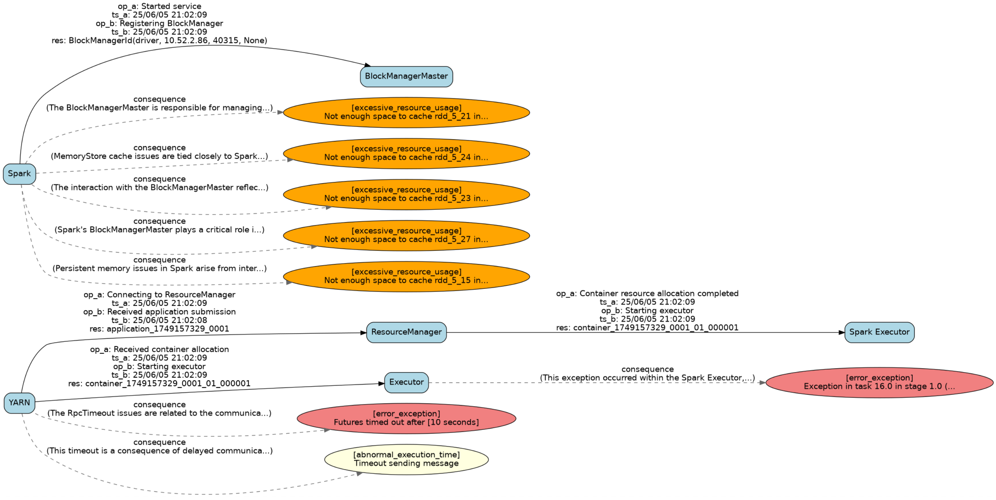
5. Discover Anomaly Interactions

Slide 14
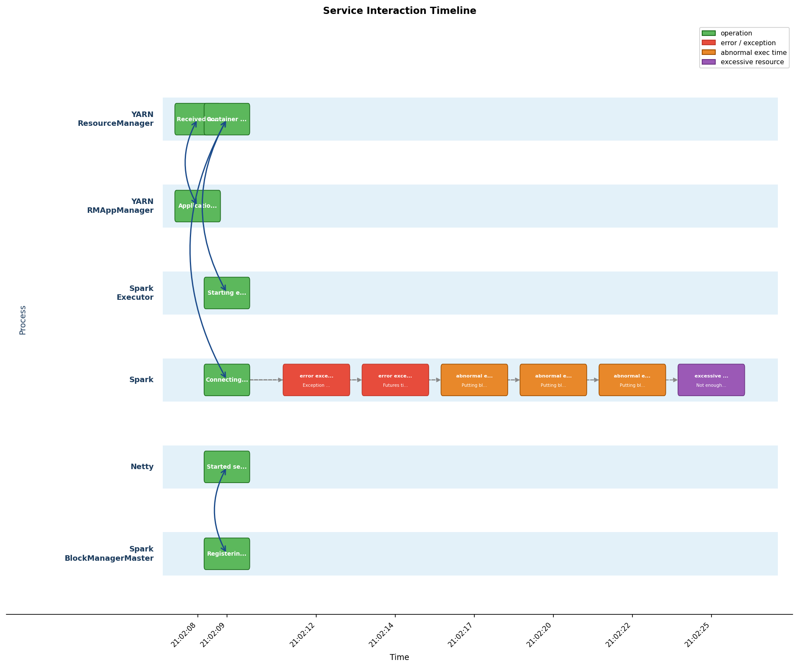
6. Higher-level modeling

Slide 15
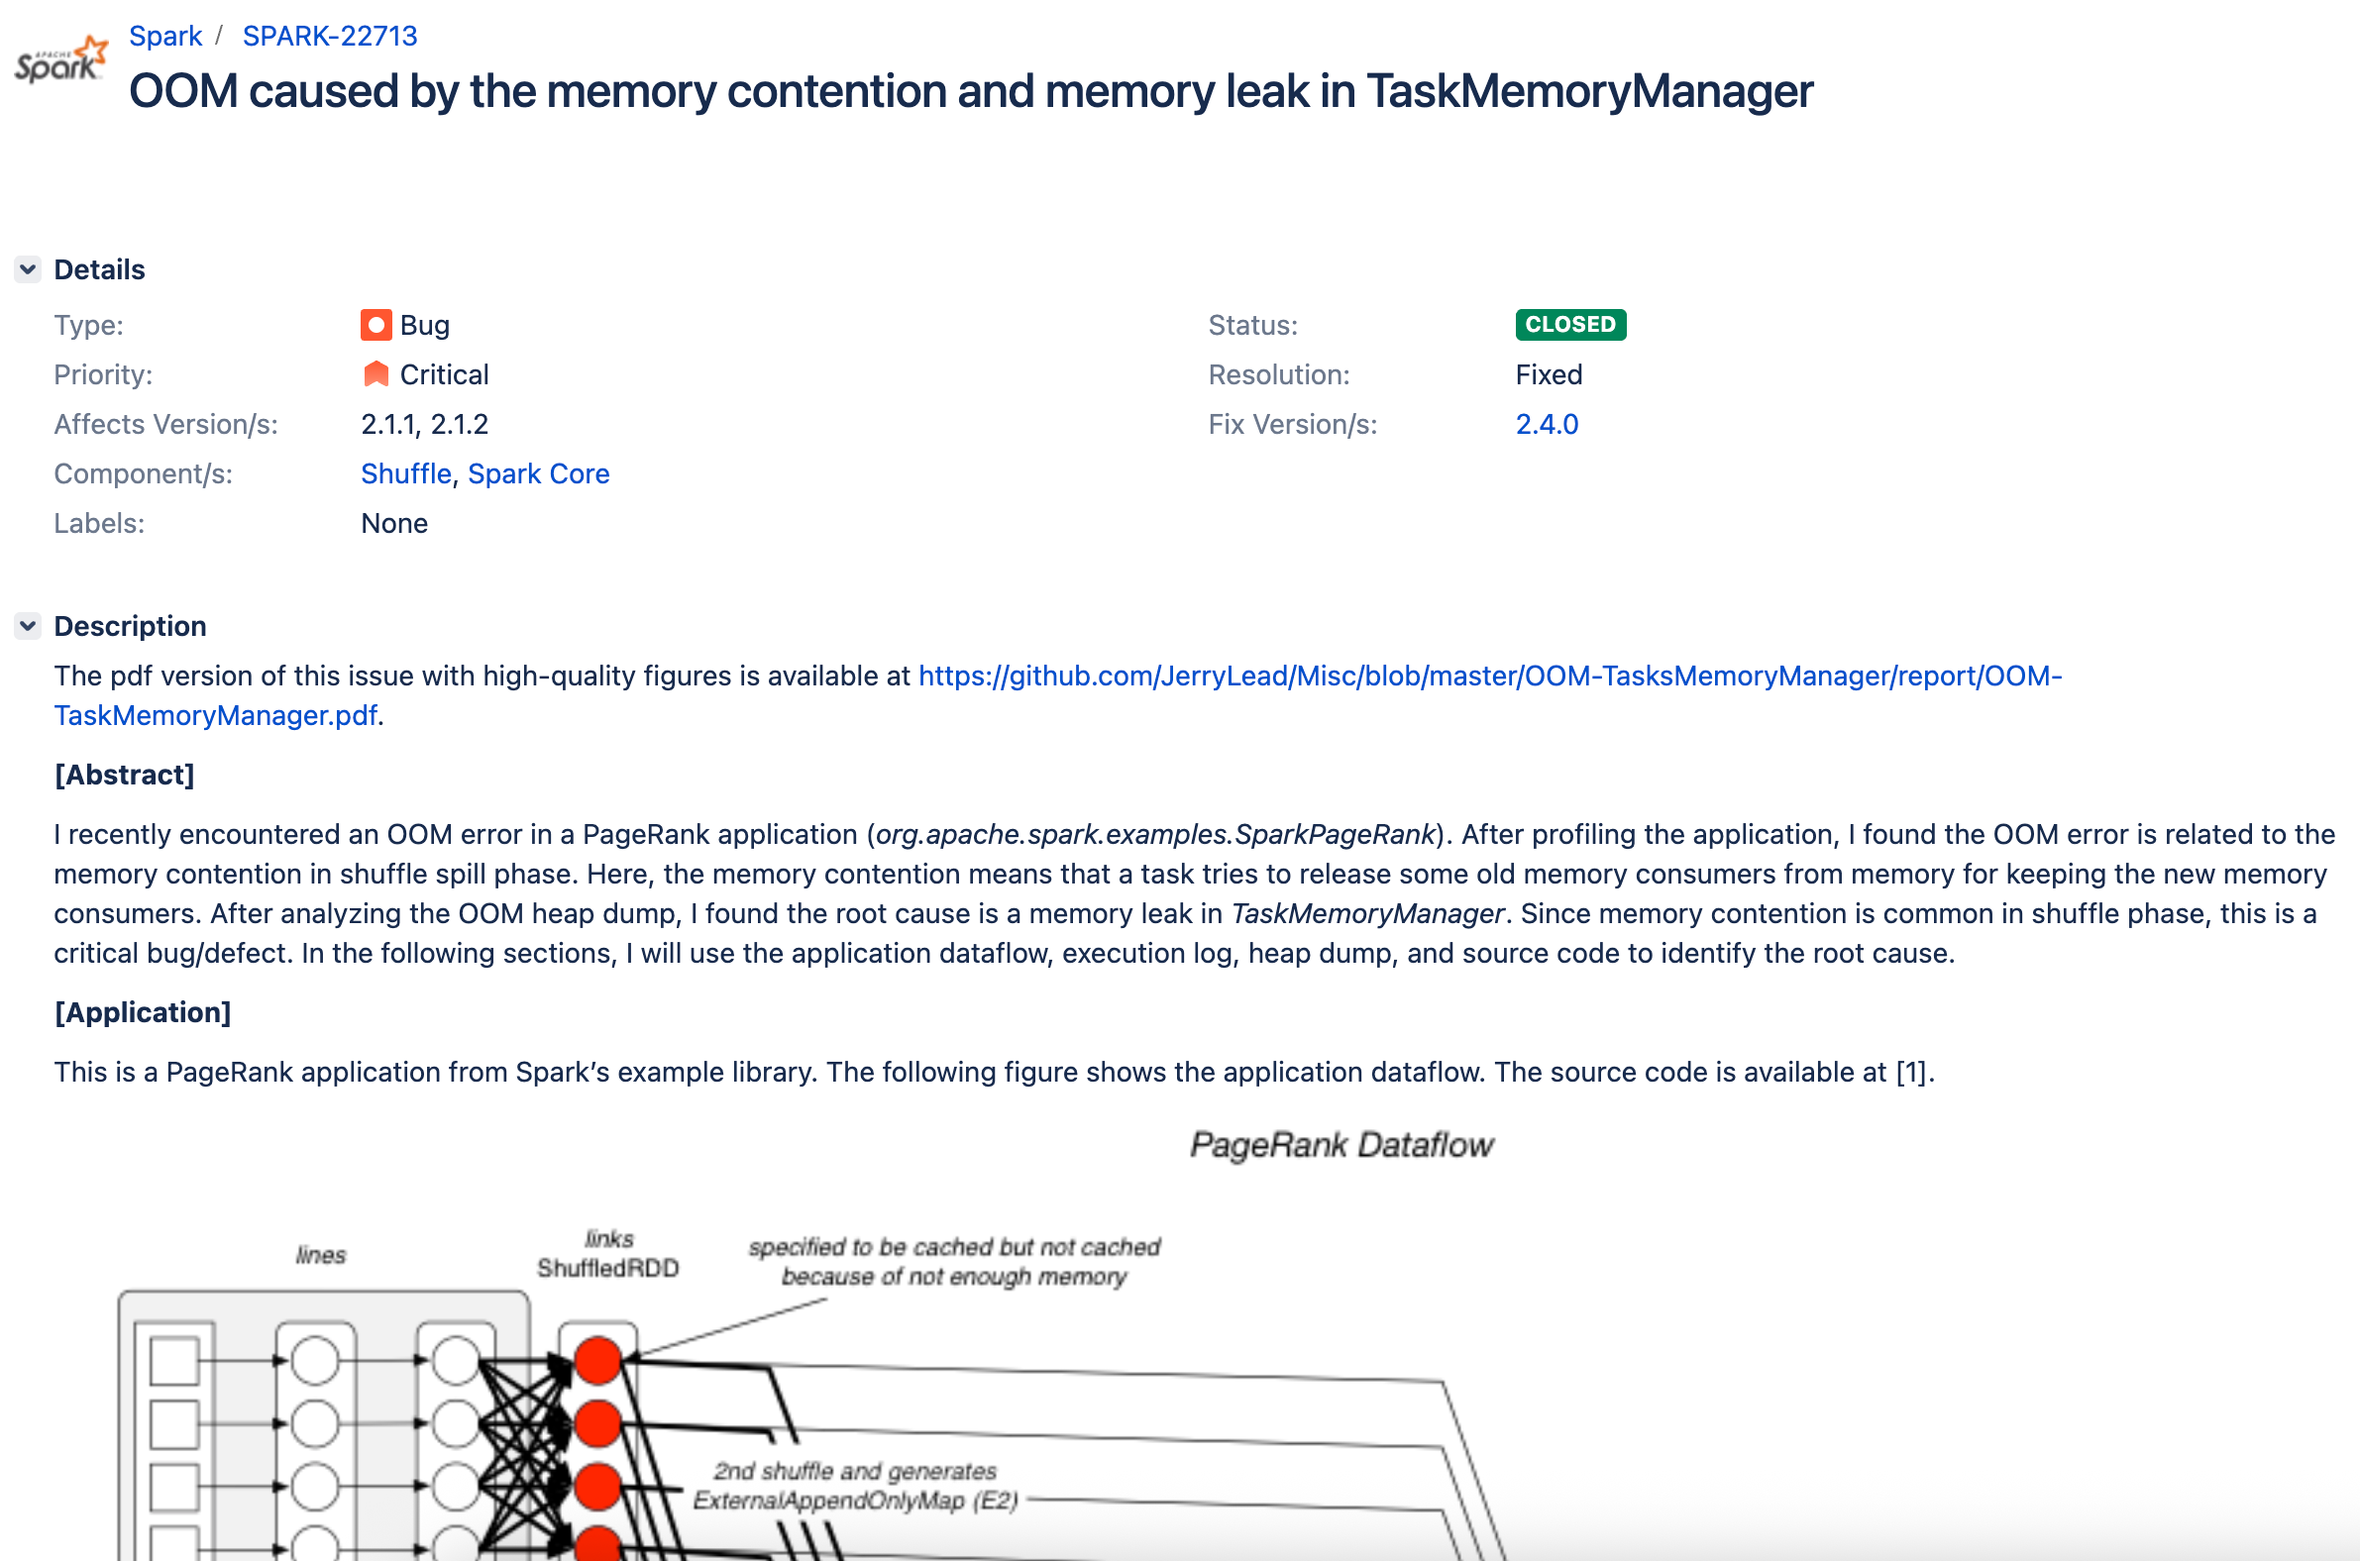
Preliminary Result

Slide 16
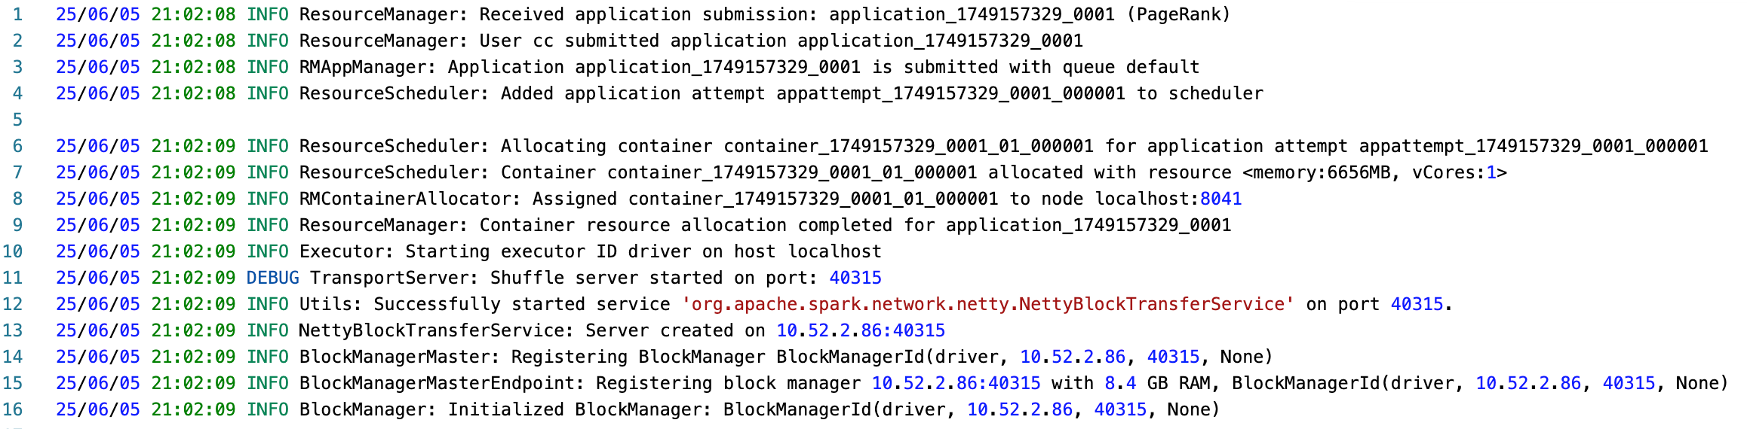
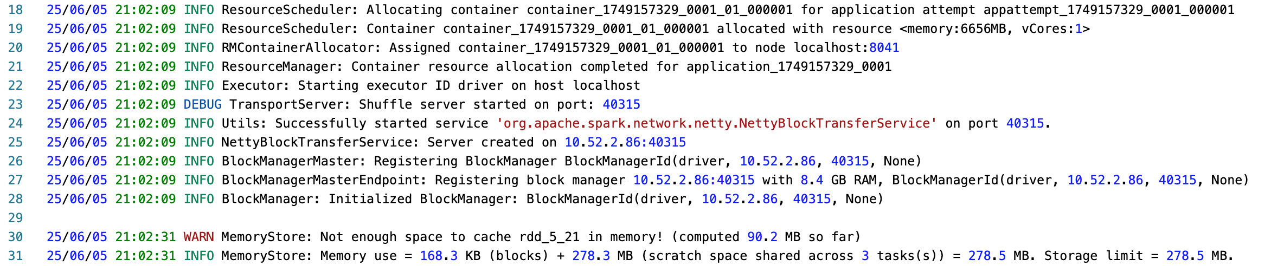
Preliminary Result
Operation
Error / exception
Abnormal time
2025-06-05
2025-06-05
2025-06-05
Excessive resource
21:02:09
21:04:20
21:06:22
Time
Block Manager
op
consequence
Services
Executor
Resource Manager
Netty
Critical path

Slide 17
Thanks

